Slide 1

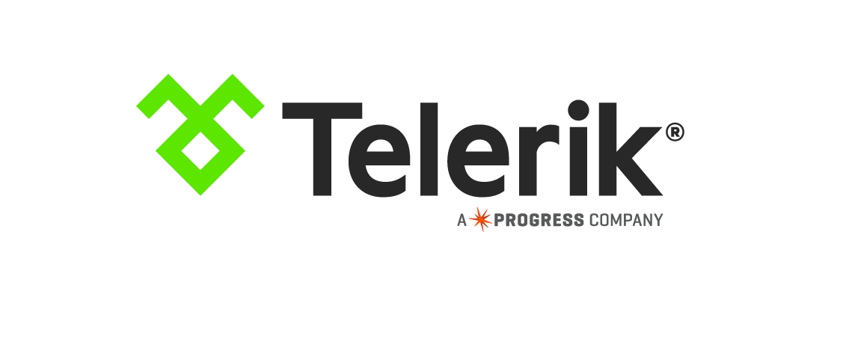
Sharing Code Between Web and Native Apps
Jen Looper (@jenlooper)
Notes:
(TJ) Hello ng-conf.
Today we’re going to be cooking up something amazing for you–as you might be able to tell from these incredible outfits we have on—we’ll be looking at how you can use Angular 2, and NativeScript which we work on, to build for both the web—as well as native mobile apps, and share some of the same code.

Slide 2
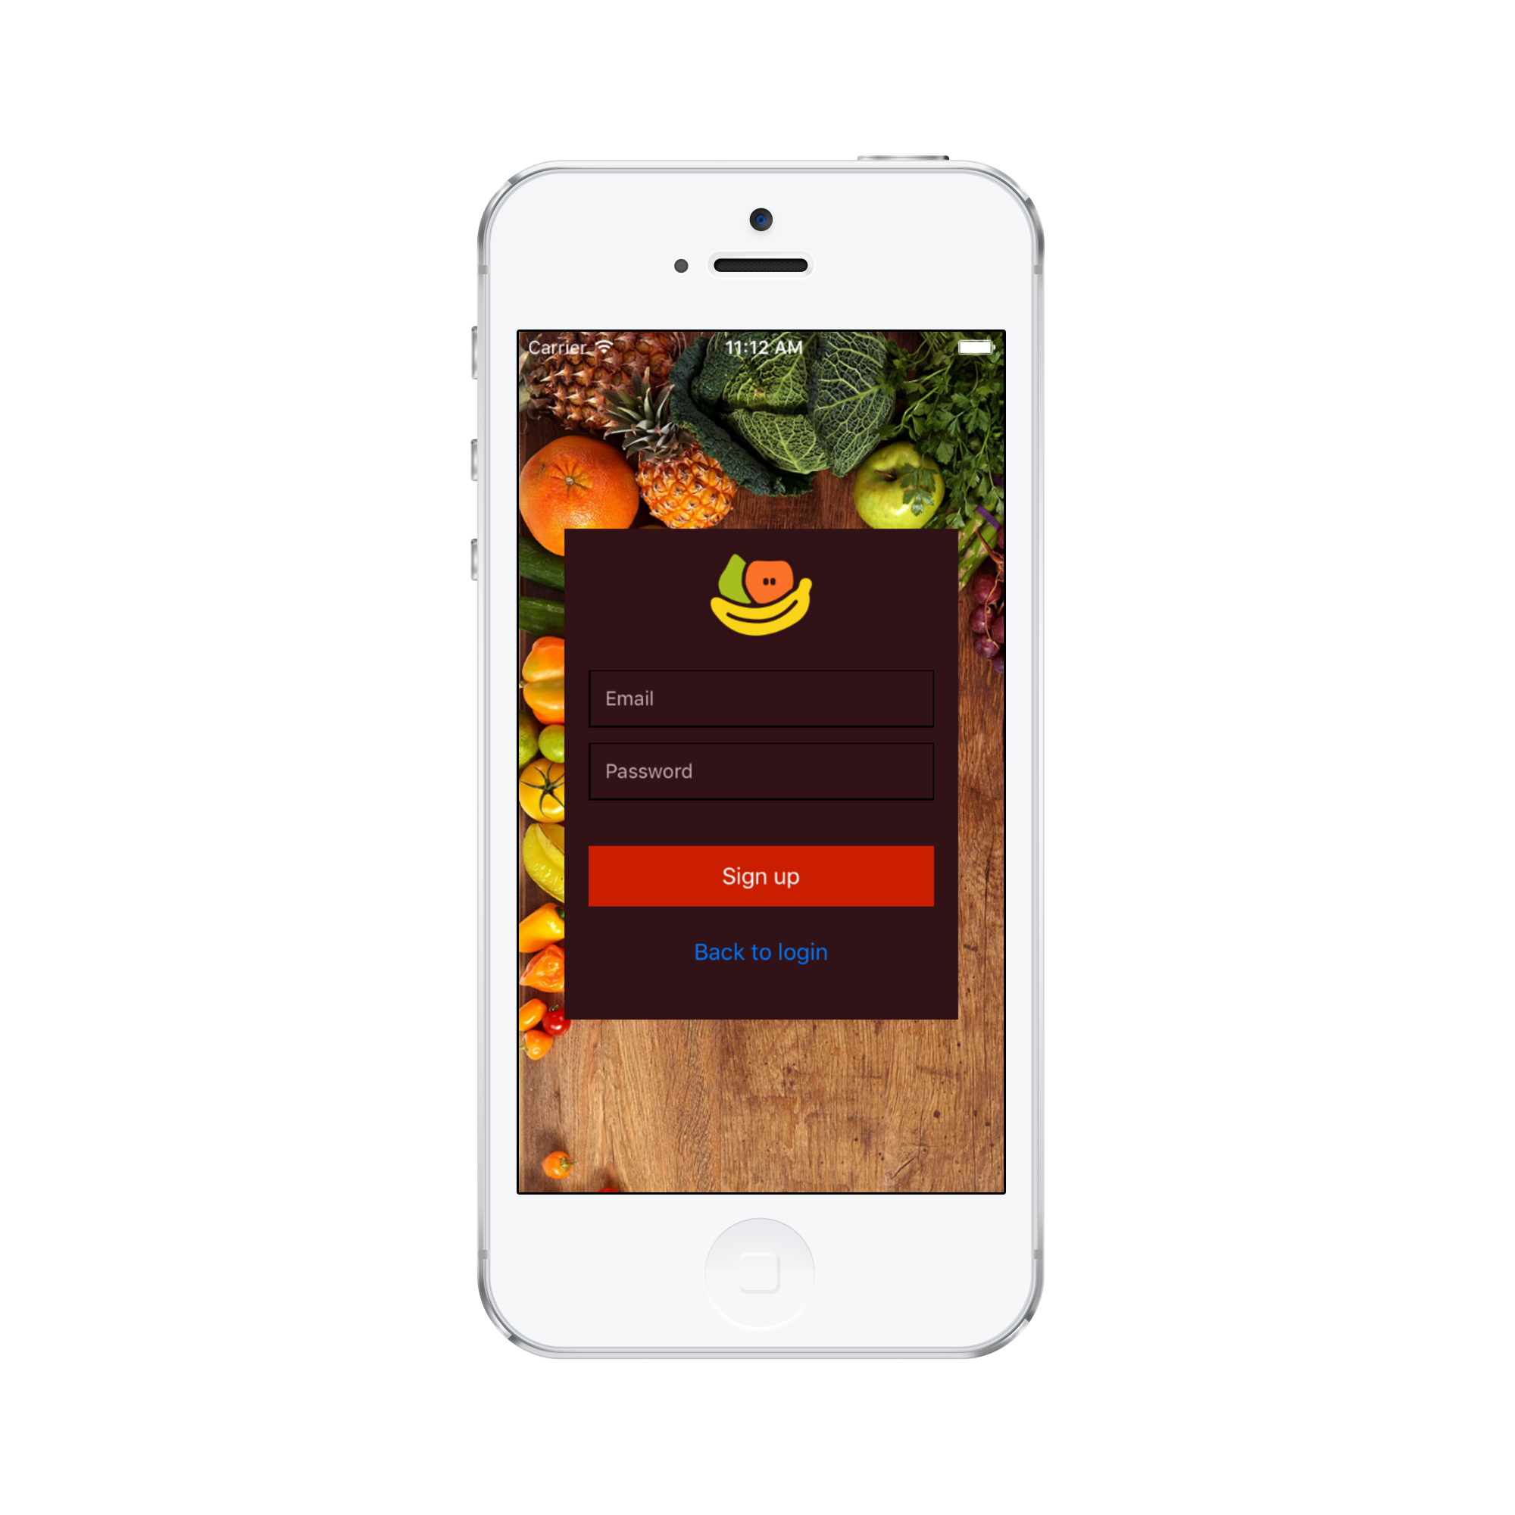
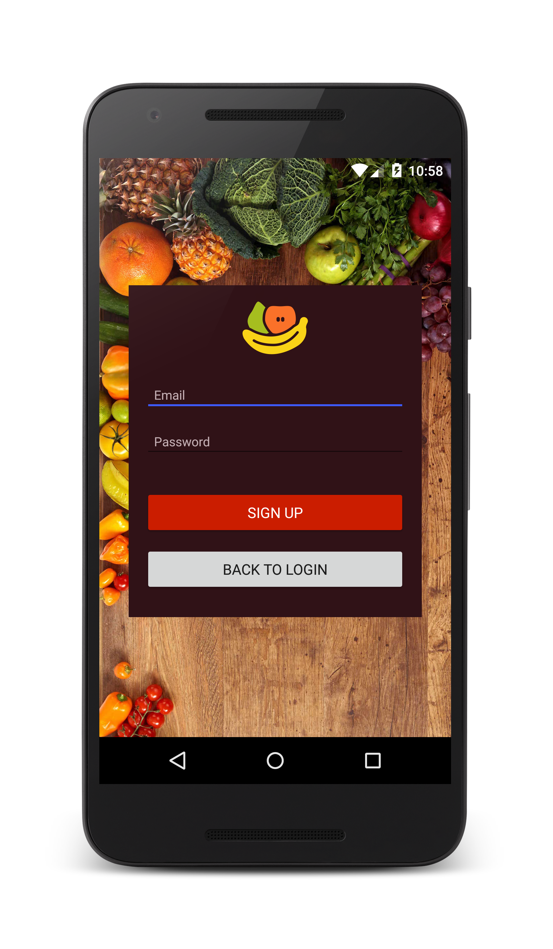

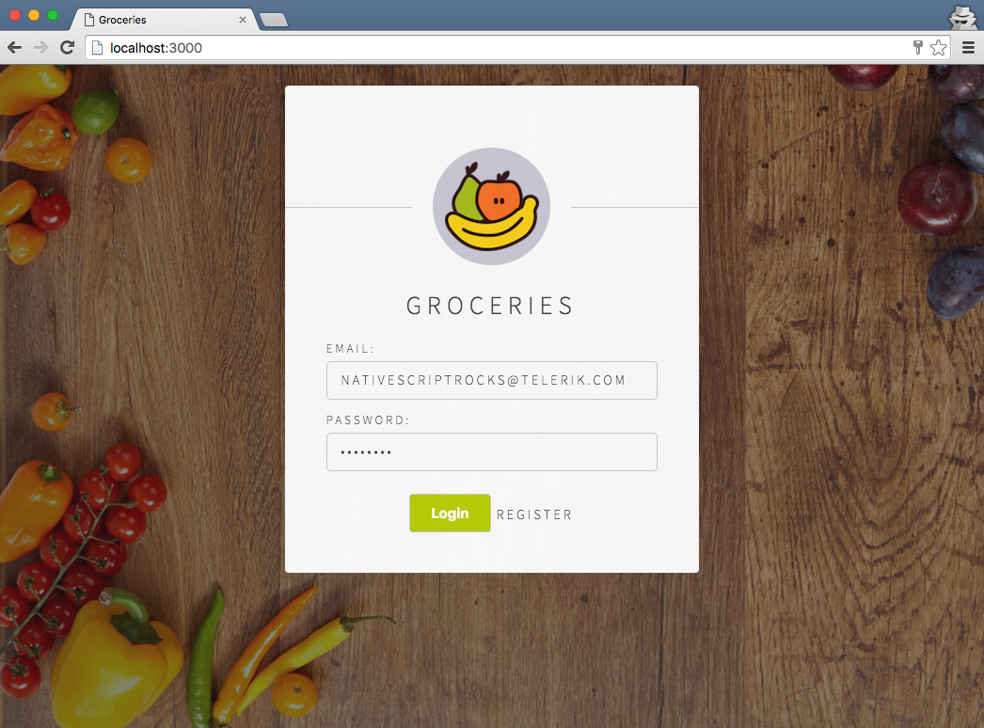
Android
iOS
Web
Notes:
We’ll be mixing up a Groceries management app, to show you just how easy it is to share web and native code. Now the idea that we can write something once, and run it everywhere is one of the reasons people are so attracted to Angular 2 - because you can use the code that you already wrote for the web, and leverage {N} to build for Android and iOS to create a truly native mobile app with no webview in sight!

Slide 3
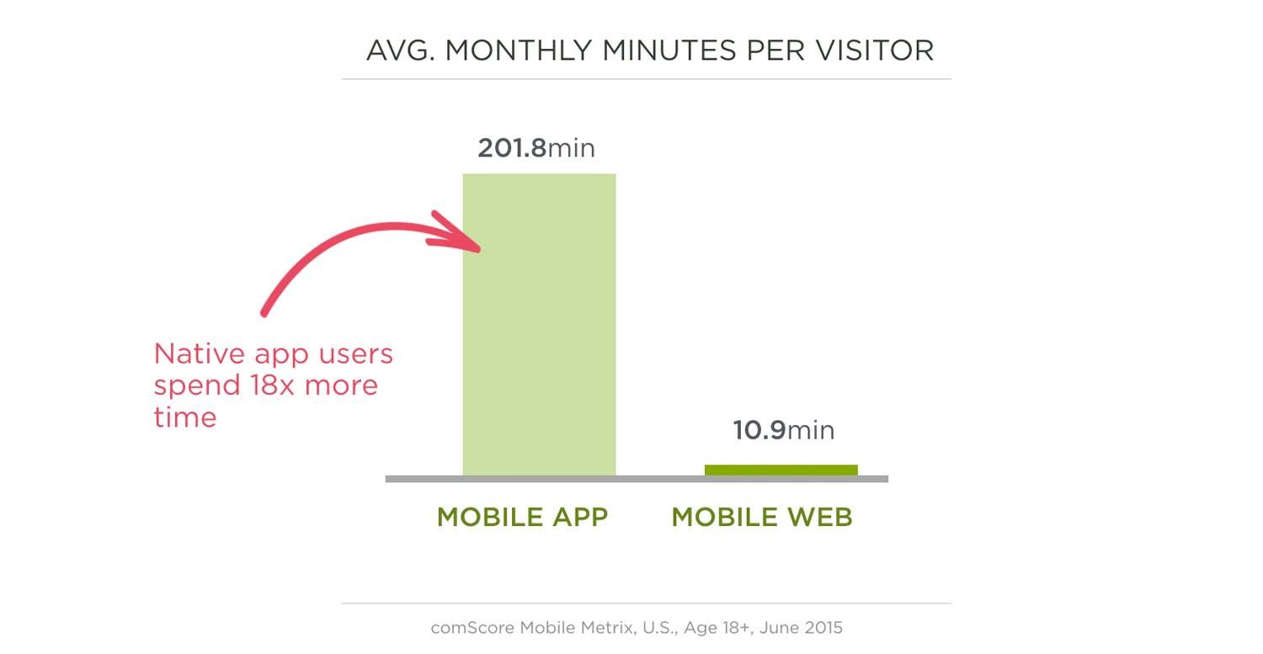
Why Native?
Via http://www.lukew.com/ff/entry.asp?1954
Notes:
(TJ) Which begs the question: why build for native at all? Why not _just_ build a web app. Well, years of usage data tells us that native and web each have their own unique advantages. Native is known for providing really rich and performant experiences. And the data tells us people use native apps almost 20x more than web apps.

Slide 4
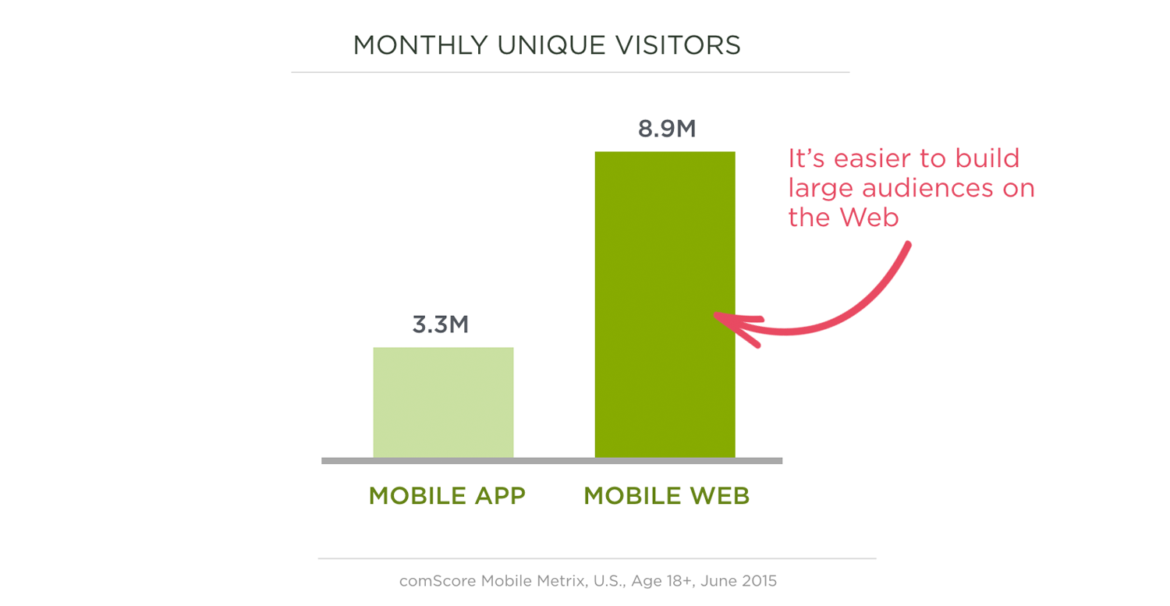
Why Web?
Via http://www.lukew.com/ff/entry.asp?1954
Notes:
(TJ) But the web is known for its reach, as the web isn’t restricted by device type or operating systems—the web runs everywhere, and is therefore a great way to reach a large and diverse set of users.

Slide 5
“The Web is for audience reach and native apps are for rich experiences. Both are strategic. Both are valuable. So when it comes to mobile, it's not Web vs. Native. It's both.”
- Luke Wroblewski
Notes:
So, as Luke has said…

Slide 6
Hitting all these platforms is hard
Multiple codebases
Fragmented platforms
Multiple language choices and IDEs
Keeping features in sync
Notes:
(TJ)

Slide 7


Mix Well
Notes:
(Jen) So what we’re going to do is take our Angular 2 codebase, mix it well with NativeScript, and…

Slide 8

Notes:
(Jen) …we’ll get Angular for {N}, or Nangular, or something.

Slide 9
Notes:
(Jen) So let’s see how this all works. Today we have a 3-course meal prepared for you. We’ll start with a bit of setup, just so we can see some of the special considerations inherent to building for multiple platforms. Then we’ll build up a small native mobile app so you can see this all in action. And finally we’ll end with a discussion of strategies for building your own apps moving forward.

Slide 10
Angular 2 advanced seed
http://bit.ly/nativescript-angular-seed
Notes:
(Jen)

Slide 11
Try it for yourself!
1) Visit nativescript.org and click Get Started!
2) Follow @nativescript on Twitter.
3) Reach out! @tjvantoll and @jenlooper on Twitter.
Notes:
(TJ)

